Slide 1



Slide 2
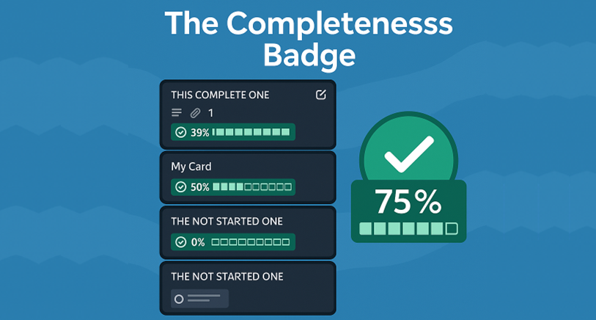

Slide 3



Completeness Chart

